Slide 1




GURU RATCHITHA S
FINAL PROJECT

Slide 2
“LOAN APPROVAL
PREDICTION
USING “ANN”

Slide 3
AGENDA
PROBLEM STATEMENT
01 - BRANDING
PROPOSED SYSTEM
SYSTEM DEVELOPMENT APPROACH
ALGORITHM & DEPLOYMENT
RESULTS
CONCLUSION
03 - SOCIAL MEDIA

Slide 4
PROBLEM STATEMENT
The objective of this project is to develop an Artificial Neural Network (ANN) model that accurately predicts the approval status of loan applications based on various applicant features.
By leveraging historical data on loan applicants and their approval outcomes, the model aims to assist financial institutions in automating the loan approval process and making more informed decisions.

Slide 5
PROPOSED SOLUTION
I used a dataset with detailed applicant information to train an Artificial Neural Network (ANN) using TensorFlow and Keras.
Through experimentation with various ANN architectures and hyperparameters, I optimized the model for predicting loan approval statuses. Evaluation metrics like accuracy were employed to ensure the model's effectiveness.
Once validated, the ANN model can be deployed in financial institutions to automate loan approval processes, improving efficiency and decision-making.

Slide 6
SYSTEM DEVELOPMENT APPROACH
HARDWARE REQUIREMENTS:
CPU or GPU: A multi-core processor is recommended for faster data processing and model training. A minimum of a dual-core CPU is sufficient, but a quad-core or higher is preferable for improved performance.
RAM: A minimum of 8GB RAM is recommended, but 16GB or higher is preferable for smoother performance.
Storage: At least 100GB of free disk space is recommended, depending on the size of the dataset and project requirements.

Slide 7
SYSTEM DEVELOPMENT APPROACH
SOFTWARE REQUIREMENTS:
Operating System: The code can be run on any major operating system, including Windows, macOS, or Linux distributions such as Ubuntu.
Python: Install Python programming language (version 3.x) on your system.
Python Libraries: import libraries like Pandas,numpy,matplotlib and seaborn,
scikit-learn,tensorflow and keras.
IDE (Integrated Development Environment): choose an IDE or text editor for coding and running Python scripts.

Slide 8
ALGORITHM AND DEPLOYMENT
Data Preprocessing: Clean the dataset, handle missing values, and encode categorical variables.
Model Building: Design an ANN architecture using TensorFlow and Keras with appropriate layers, neurons, and activation functions.
Model Training: Train the ANN model using historical loan application data, optimizing hyperparameters for accuracy.
Model Evaluation: Evaluate the trained model's performance using metrics such as accuracy, precision, recall, and F1-score.
Prediction: Utilize the trained ANN model to predict loan approval statuses for new loan applications, enabling automated decision-making in financial institutions.
Deployment: Deploy the trained model into production to streamline the loan approval process and enhance decision-making efficiency.

Slide 9
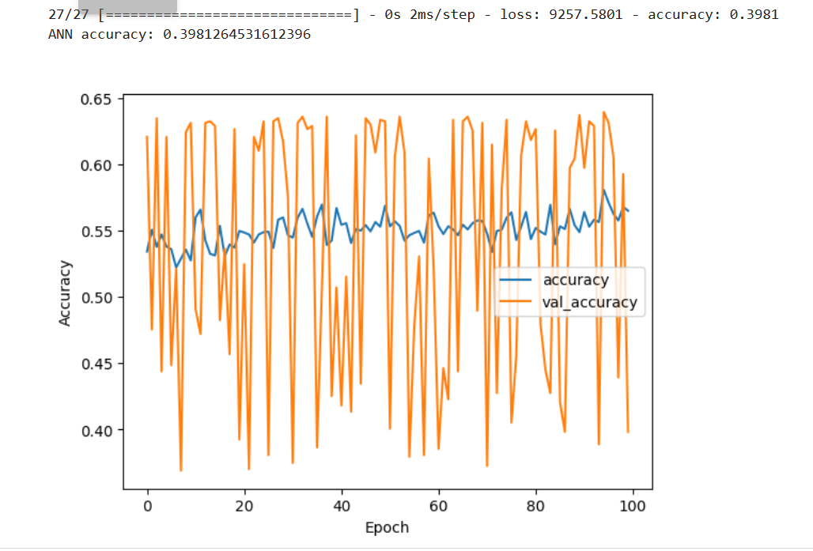
RESULTS

Slide 10
CONCLUSION:
In conclusion,the ANN model accurately predicts loan approval statuses, enhancing decision-making in financial institutions by automating processes, reducing manual effort, and improving risk management. Its deployment signifies a significant advancement in financial technology, ensuring data-driven lending practices and boosting customer satisfaction.

